Slide 1
NAPREDNI JAVASCRIPT
Metode nad stringovima

Slide 2
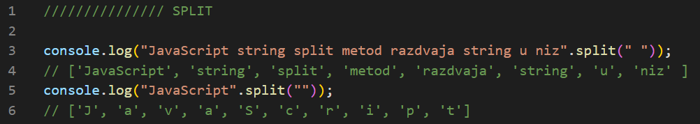
SPLIT

Slide 3
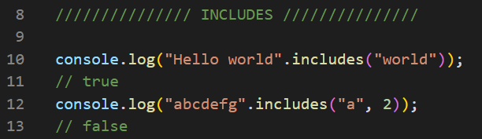
INCLUDES

Slide 4
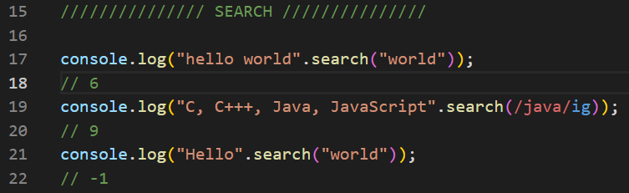
SEARCH

Slide 5
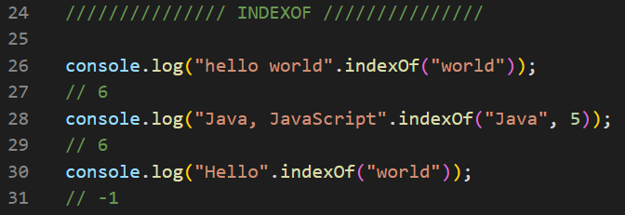
INDEXOF

Slide 6
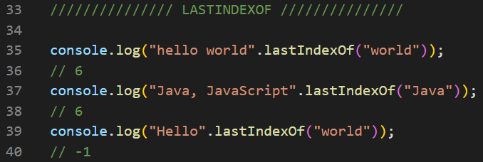
LASTINDEXOF

Slide 7
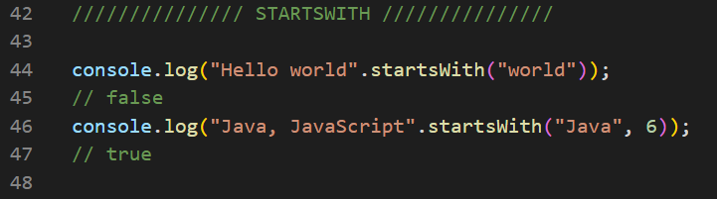
STARTSWITH

Slide 8
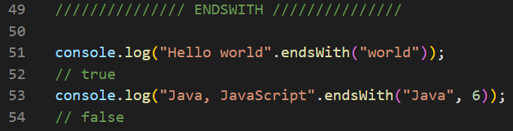
ENDSWITH

Slide 9
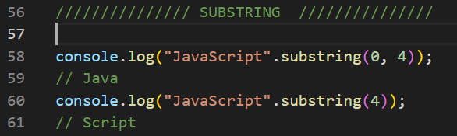
SUBSTRING

Slide 10
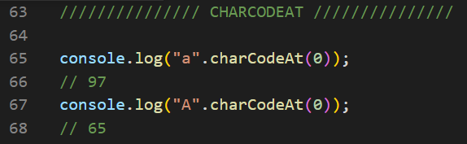
CHARCODEAT

Slide 11
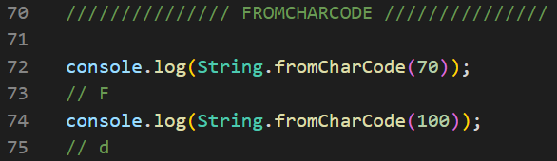
FROMCHARCODE

Slide 12
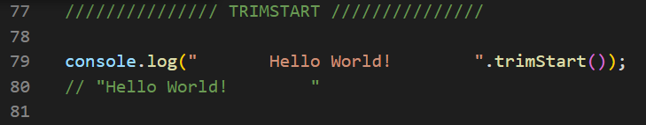
TRIMSTART

Slide 13
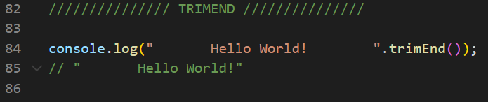
TRIMEND

Slide 14
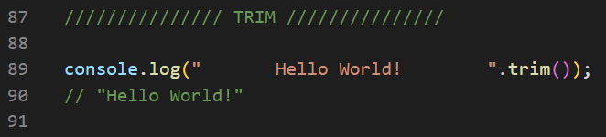
TRIM

Slide 15
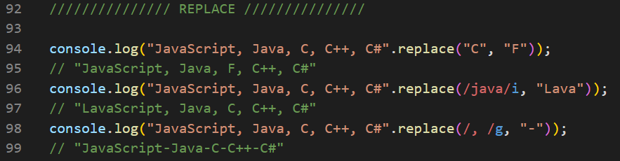
REPLACE

Slide 16
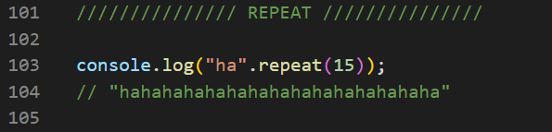
REPEAT

Slide 17
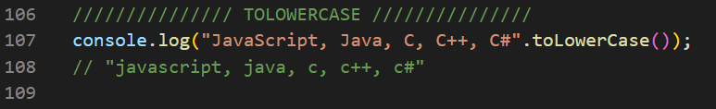
TOLOWERCASE

Slide 18
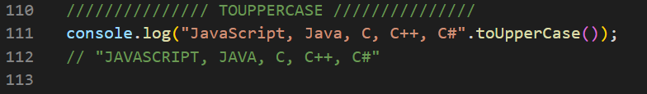
TOUPPERCASE

